Slide 1


APPLIED PHYSICS 186 – ACTIVITY 15
MACHINE LEARNING:
Expectation
Maximization
Professor: Dr. Maricor Soriano
Instructor: Jayson Cubero
Rene L. Principe Jr.
2015-04622

Slide 2
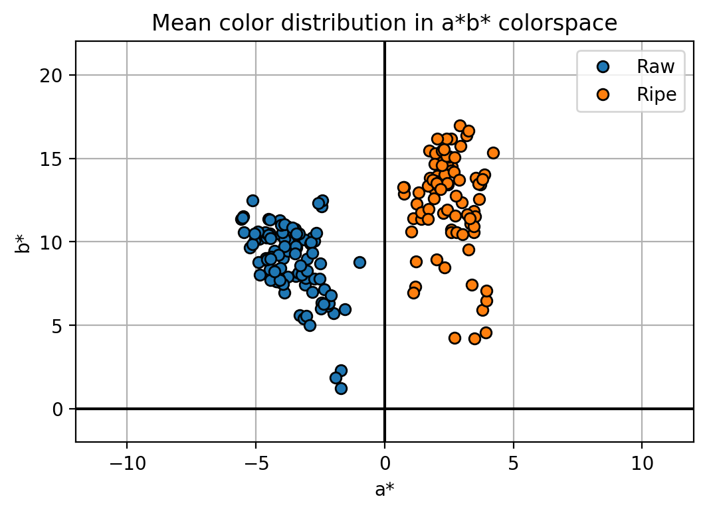
dataset
The goal of this activity is to provide a comprehensive probability map by deriving the optimized gaussian fits from the calculated mean and covariance representation. In this activity, we’ll be using the color features a* and b* and employ the expectation maximization algorithm.
Figure 1. Color features a* and b* of raw and ripe bananas shall be used to determine a continuous ripeness variation.

Slide 3
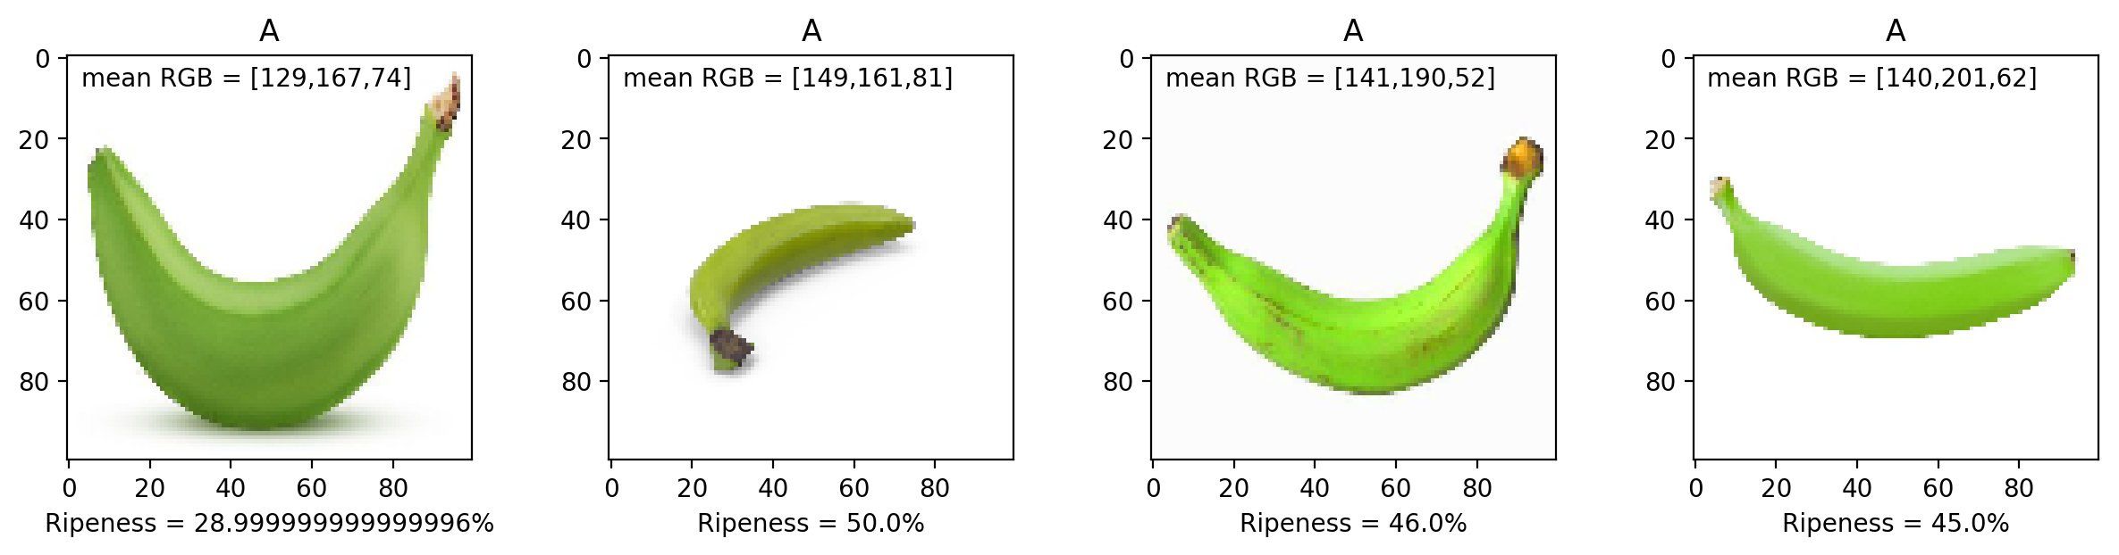
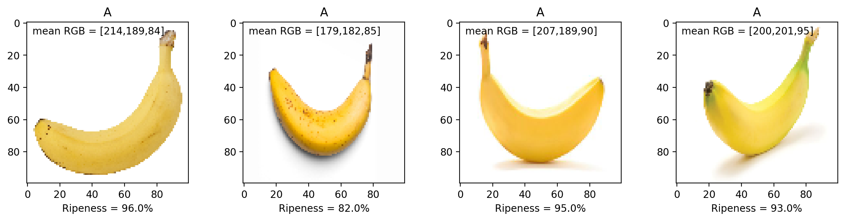
Figure 2. Ripeness prediction of never-before-seen images of raw and ripe bananas. Generally, raw bananas which are predominantly green in color has ripeness values below 50%, and the ripe yellow bananas have near 100% ripeness.

Slide 4
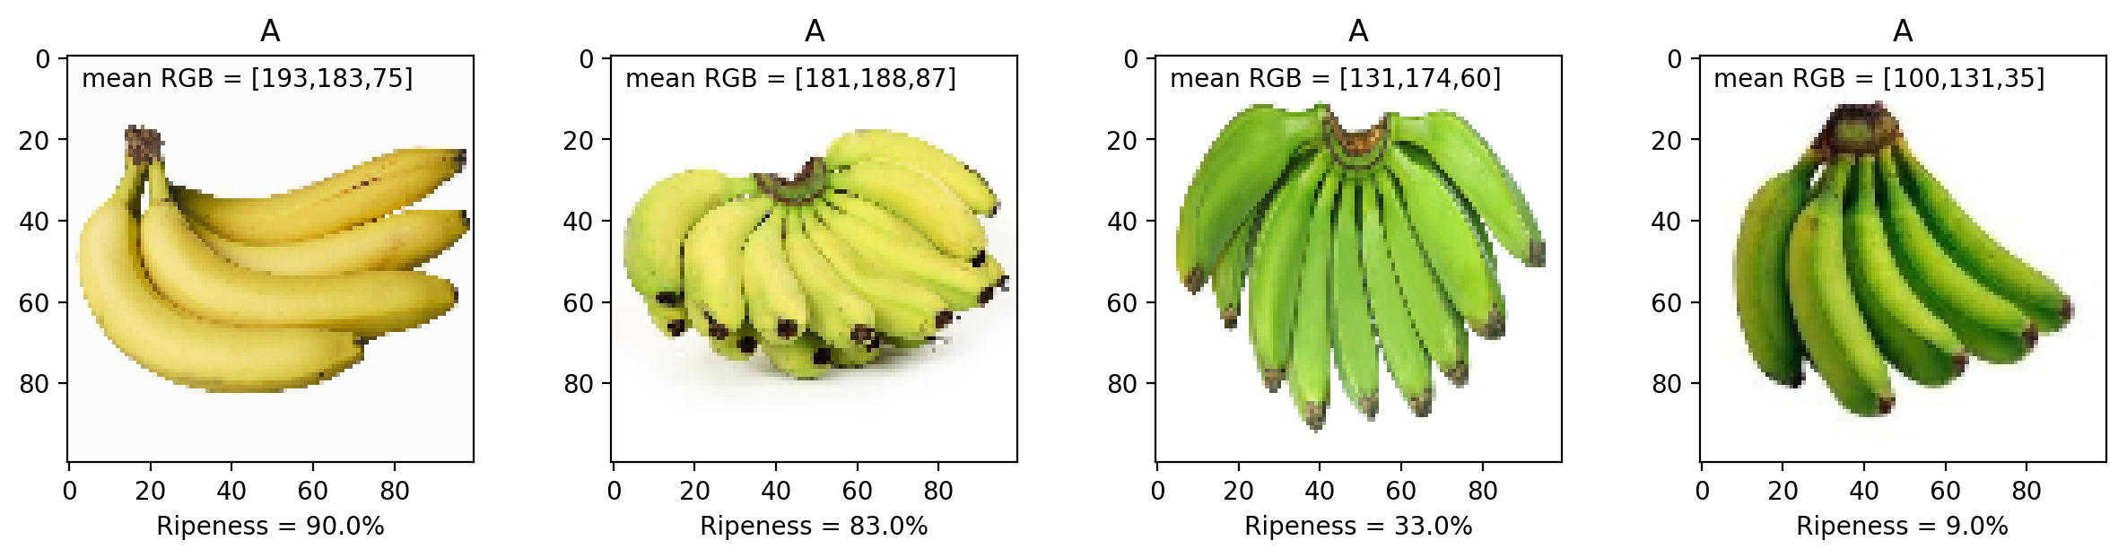
Figure 3. Ripeness has a direct correlation with color as per the logistic regression. The increase in the number of yellow pixels will introduce a shift in the mean RGB values, which in return would increase the sigmoid value, hence a higher ripeness prediction.
I have successfully quantified the ripeness of the banana fruit using its color features by the means of logistic regression. I’d give myself a 10.
I’d like to thank Kenneth Domingo for providing me a copy of the raw/ripe banana dataset.
References:
[1] M. Soriano, “Logistic Regression”, 2019.
[2] M. Oltean and H. Muresan, Fruits 360 dataset on kaggle. [Online; accessed 29.10.2019].

